Slide 1
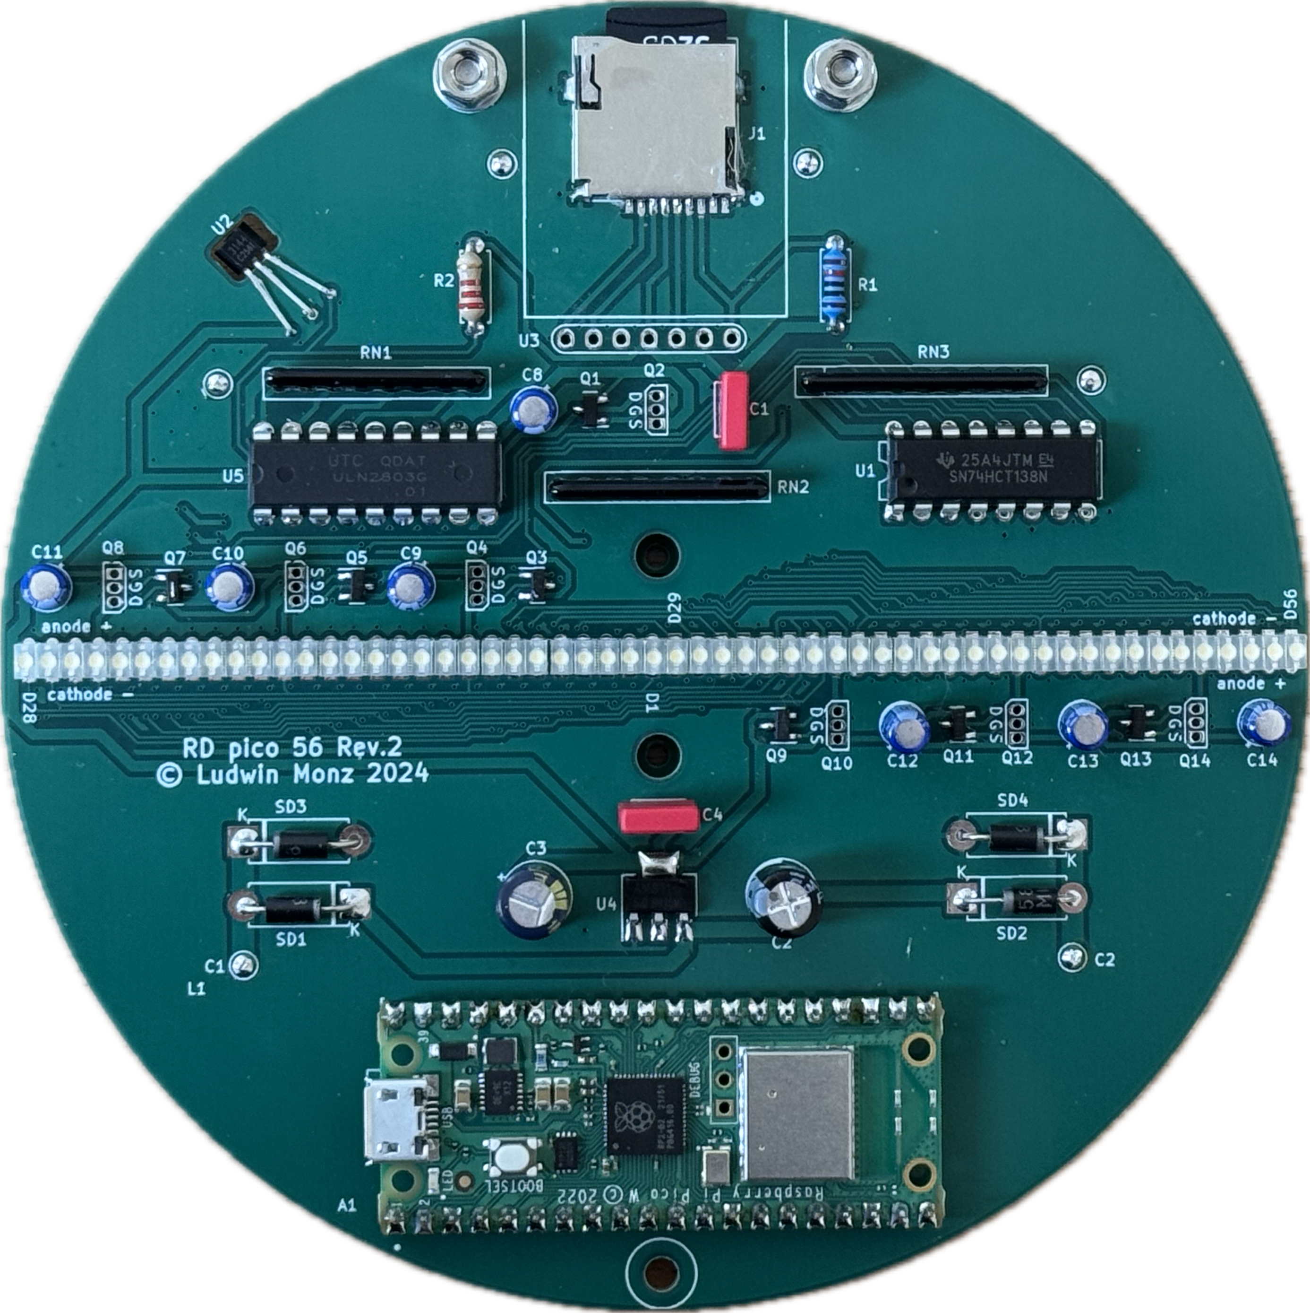
balancing weights

Slide 2
in0
in1
in2
decoder and
level converter
74HCT138
out0 out1 out2 out3 out4 out5 out6 out7
+5V
+5V
Darlington
array
. . . . . . .
p-channel MOSFET
bit 7
bit 6
bit 5
bit 4
bit 3
bit 2
bit 1
bit 0
ULN2803

Slide 3
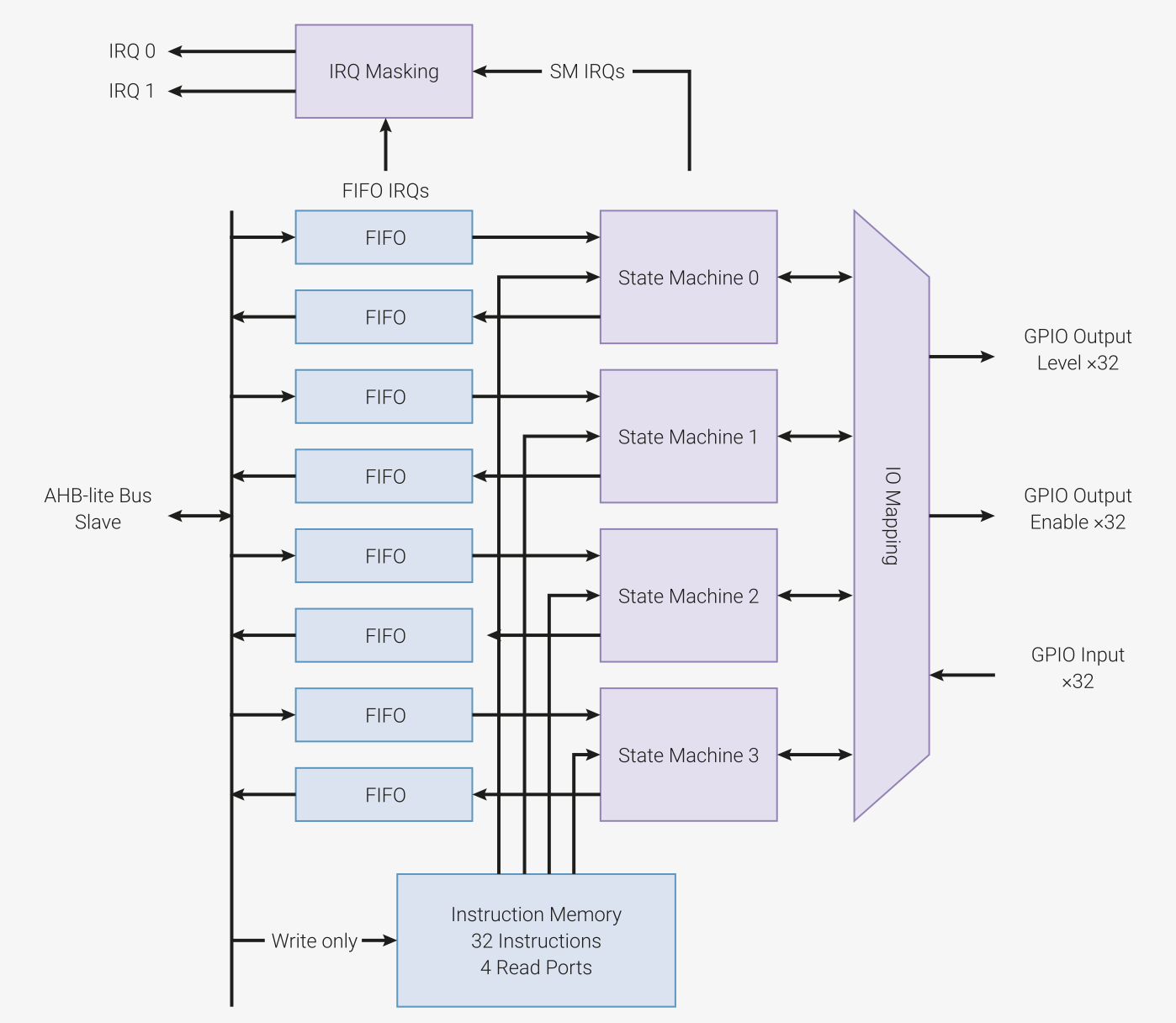
RP2040
programmable IO (pio)
GPIO 0
GPIO 1
.
.
.
.
GPIO 7
GPIO 8
GPIO 9
GPIO 10
column row

Slide 4
Hall sensor trigger
Hall interrupt
1/turn
100 ms
restart line count
calculate time per turn, program pixel interrupt
pixel interrupt
240/turn
420 µs
subpixel
8/pixel
52 µs
multiplexing columns
7/subpixel
7.5 µs

Slide 5
